Slide 1
HEART DISEASE PREDICTION
SUBMITTED BY: Sparsh Gagneja
CLASS: D3CSE B1
UNI ROLL NO.: 1706522
CLASS ROLL NO.: 1715107

Slide 2
HEART DISEASE PREDICTION SYSTEM
Among various life-threatening diseases, heart disease has garnered a great deal of attention in medical research. The diagnosis of heart disease is a challenging task, which can offer automated prediction about the heart condition of patient so that further treatment can be made effective. The diagnosis of heart disease is usually based on signs, symptoms and physical examination of the patient. There are several factors that increase the risk of heart disease, such as body cholesterol level, family history of heart disease, high blood pressure, maximum heart rate achieved and lack of physical exercise.

Slide 3
WHAT IS MACHINE LEARNING
Machine learning is an application of artificial intelligence (AI) that provides systems the ability to automatically learn and improve from experience without being explicitly programmed. Machine learning focuses on the development of computer programs that can access data and use it learn for themselves.
The process of learning begins with observations or data, such as examples, direct experience, or instruction, in order to look for patterns in data and make better decisions in the future based on the examples that we provide. The primary aim is to allow the computers learn automatically without human intervention or assistance and adjust actions accordingly.

Slide 4
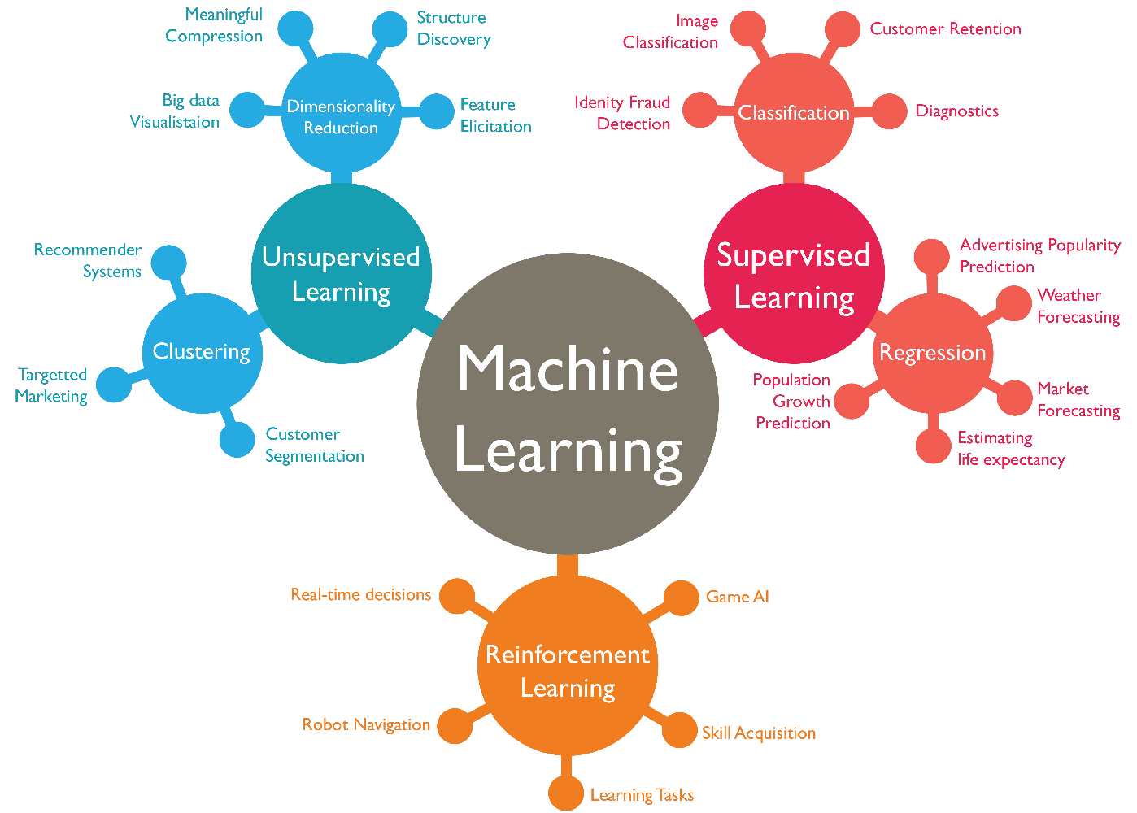

Slide 5
SUPERVISED LEARNING
Supervised learning as the name indicates the presence of a supervisor as a teacher. Basically supervised learning is a learning in which we teach or train the machine using data which is well labeled that means some data is already tagged with the correct answer. After that, the machine is provided with a new set of examples(data) so that supervised learning algorithm analyses the training data(set of training examples) and produces a correct outcome from labeled data.
it is of 2 types:
Classification
Regression

Slide 6
SUPERVISED LEARNING
Types of Supervised Learning:
Classification : It is a Supervised Learning task where output is having defined labels(discrete value). The goal here is to predict discrete values belonging to a particular class and evaluate on the basis of accuracy. It can be either binary or multi class classification. In binary classification, model predicts either 0 or 1 ; yes or no but in case of multi class classification, model predicts more than one class.
Example: Gmail classifies mails in more than one classes like social, promotions.
Regression : It is a Supervised Learning task where output is having continuous value.
The goal here is to predict a value as much closer to actual output value as our model can and then evaluation is done by calculating error value. The smaller the error the greater the accuracy of our regression model.
Example : Linear Regression, Nearest Neighbour,Guassian Naive Bayes.

Slide 7
UNSUPERVISED LEARNING
Unsupervised learning is the training of machine using information that is neither classified nor labeled and allowing the algorithm to act on that information without guidance. Here the task of machine is to group unsorted information according to similarities, patterns and differences without any prior training of data.
It is of 2 types:
Clustering: A clustering problem is where you want to discover the inherent groupings in the data, such as grouping customers by purchasing behavior.
Association: An association rule learning problem is where you want to discover rules that describe large portions of your data, such as people that buy X also tend to buy Y.

Slide 8
WHY PYTHON FOR MACHINE LEARNING
A great library ecosystem
A low entry barrier
Flexibility
Platform independence
Readability
Good visualization options
Community support
Growing popularity

Slide 9
PYTHON LIBRARIES USED
NUMPY
MATPLOTLIB
SKLEARN
PYQT5

Slide 10
LOGISTIC REGRESSION
Logistic Regression is a Machine Learning classification algorithm that is used to predict the probability of a categorical dependent variable. In logistic regression, the dependent variable is a binary variable that contains data coded as 1 (yes, success, etc.) or 0 (no, failure, etc.). In other words, the logistic regression model predicts P(Y=1) as a function of X.
Logistic Regression Assumptions:
Binary logistic regression requires the dependent variable to be binary
For a binary regression, the factor level 1 of the dependent variable should represent the desired outcome.
Only the meaningful variables should be included.
The independent variables should be independent of each other. That is, the model should have little or no multi collinearity.
Logistic regression requires quite large sample sizes.

Slide 11
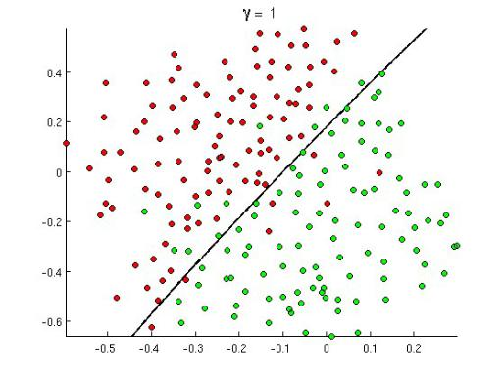
LOGISTIC REGRESSION
Logistic regression is a supervised learning classification algorithm used to predict the probability of a target variable. The nature of target or dependent variable is dichotomous, which means there would be only two possible classes.
In simple words, the dependent variable is binary in nature having data coded as either 1 (stands for success/yes) or 0 (stands for failure/no).
Mathematically, a logistic regression model predicts P(Y=1) as a function of X. It is one of the simplest ML algorithms that can be used for various classification problems such as spam detection, Diabetes prediction, cancer detection, heart disease prediction etc.

Slide 12
What is Logistic Regression?
Logistic regression is a statistical method for analysing a dataset in which there are one or more independent variables that determine an outcome. The outcome is measured with a dichotomous variable (in which there are only two possible outcomes). It is used to predict a binary outcome (1 / 0, Yes / No, True / False) given a set of independent variables.
You can also think of logistic regression as a special case of linear regression when the outcome variable is categorical, where we are using log of odds as dependent variable. In simple words, it predicts the probability of occurrence of an event by fitting data to a logit function.
Remember, there are some cases where dependent variables can have more than two outcomes, like married /unmarried/divorced such scenarios are classified as multinomial logistic regression. Though they work in the same manner to predict the outcome .
Some Familiar Example Of Logistics Regression :
Some prominent examples like:
Email Spam Filter: Spam /No Spam
Fraud Detection : Transaction is fraudulent, Yes/No

Slide 13
HOW DOES LOGISTIC REGRESSION WORK?
As we are clear that logistics regression majorly makes predictions to handle problems which require a probability estimate as output, in the form of 0/1. Logistic regression is an extremely efficient mechanism for calculating probabilities. So you must be curious to understand how does it comes out with the value of 0 or 1 always. To understand more let’s try to decode some math behind Logistic Regression.
LOGISTIC MODEL: SIGMOID FUNCTION
In order to map predicted values to probabilities, we use the Sigmoid function. The function maps any real value into another value between 0 and 1. In machine learning, we use sigmoid to map predictions to probabilities.
Let us try to understand logistic regression by understanding the logistic model. As in linear regression let’s represent our hypothesis(Prediction Of Dependent Variable) in classification. In classification our hypothesis representation which tries to predict the binary outcome of either o or 1, will look like,
hθ(x) = g(θ T x) = 1/ 1 + e −θ T x ,
Here g(z) = 1/( 1 + e ^−z), is called the logistic function or the sigmoid function:

Slide 14
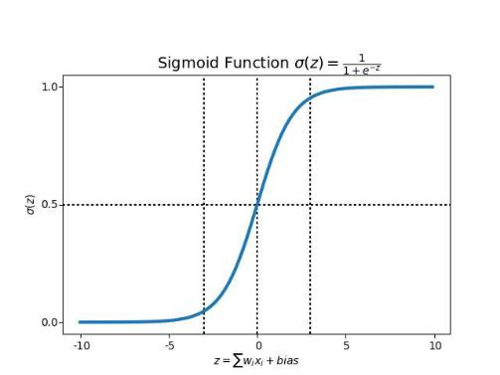
LOGISTIC MODEL: SIGMOID FUNCTION
g(z): is a representation of logistic function, which we also call a Sigmoid function. From the above visual representation of sigmoid function, we can easily decipher how this curve describes many real-world situations, like population growth. In the initial stages it shows an exponential growth, but after some time, due to the competition for certain resources (bottle neck), the growth rate decreases until it gets to a stalemate and there is no growth.
The question here is, how does this logit (sigmoid function )helps us determine the probability of a classifying data into different classes. Let’s try to understand how our logit function is calculated which will give us some clarity

Slide 15
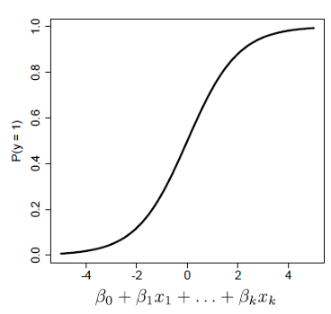
MATHS BEHIND LOGISTIC FUNCTION:
Step 1: Classifying inputs to be in class zero or one.
First, we need to compute the probability that an observation belongs to class 1(we can also call it to be a positive class) using the Logistic Response Function.
Figure: Predicting a probability for observations belonging to class

Slide 16

MATHS BEHIND LOGISTIC FUNCTION:
The coefficient beta 0, beta 1, beta K as shown in the fig above are selected to maximize the likelihood of predicting a high probability for observations belonging to class 1,
And predicting a low probability for observations actually belonging to class 0. Above fig is depicting what we are trying to do with the coefficients.
Log Odds( Logit Function):
Understanding the probabilities to classify elements into classes(1 or 0) is by using ODDS

Slide 17
MATHS BEHIND LOGISTIC FUNCTION:
These Odds which resembles similarity to a linear regression is called the logit.
So, a logit is a log of odds and odds are a function of P. In logistic regression, we find
logit(P) = a + bX,
Step 2: Defining a boundary values for the odds
We now define a threshold boundary in-order to clearly classify each given input values into one of the classes.
We can choose a threshold value as per the business problem we are trying to solve , generally which is circled around 0.5. So if your probability values come out to be >0.5 we can classify such observation into class 1 type, and the rest into class 0. The choice of threshold value is generally based on error types, which are of two types , false positives, and false negatives.
A false positive error is made when the model predicts class 1, but the observation actually belongs to class 0. A false negative error is made when the model predicts class 0, but the observation actually belongs to class 1. The perfect model would classify all classes correctly: all 1´s (or trues) as 1´s, and all 0´s (or false) as 0´s. So we would have FN = FP = 0.

Slide 18
MATHS BEHIND LOGISTIC FUNCTION:
Higher threshold value
Suppose if P(y=1) > 0.7. The model is being more restrictive when classifying as 1´s, and therefore, more False Negative errors will be made.
2. Lower threshold value:
Suppose, if P(y=1) > 0.3.
The model is now being less strict and we are classifying more examples as class 1, therefore, we are making more false positives errors.

Slide 19
Types of Logistic Regression
Generally, logistic regression means binary logistic regression having binary target variables, but there can be two more categories of target variables that can be predicted by it. Based on those number of categories, Logistic regression can be divided into following types –
Binary logistic regression: It has only two possible outcomes. Example- yes or no
Multinomial logistic regression: It has three or more nominal categories. Example- cat, dog, elephant.
Ordinal logistic regression- It has three or more ordinal categories, ordinal meaning that the categories will be in a order. Example- user ratings(1–5).

Slide 20
Implementing Logistic Regression
We are going to cover this model building exercise in the following steps:
Reading Data
Analysing Data(Basic EDA/Descriptive analysis)
Train and Test(Break the sample data into two sets)
Accuracy Report(Measuring the model performance using confusion matrix )
Main Objective : To predict heart disease using Logistic Regression Classifier.

Slide 21
Now Lets see GUI Part

Slide 22
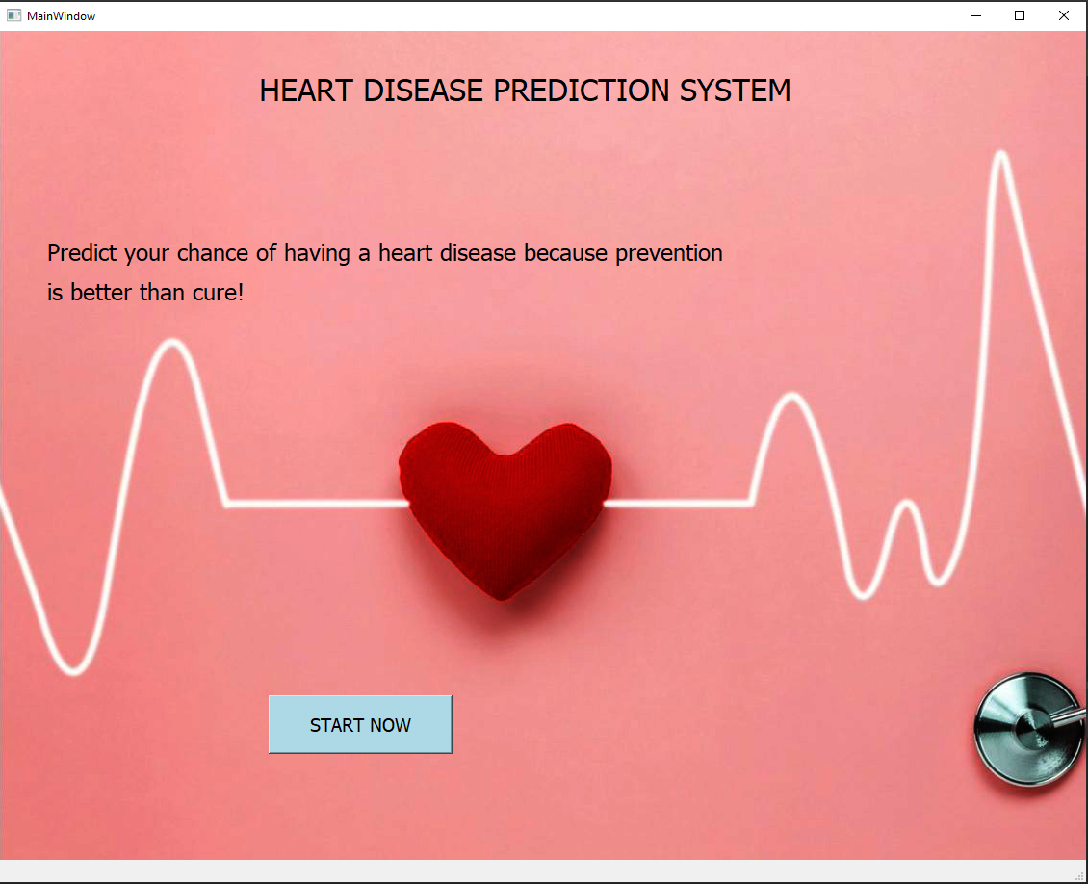
It’s a first look of my project and it contain one button
1. START NOW

Slide 23

After clicking the start now button this window will open.
In this window it have 2 buttons:
1.NEW USER
2.OLD USER

Slide 24
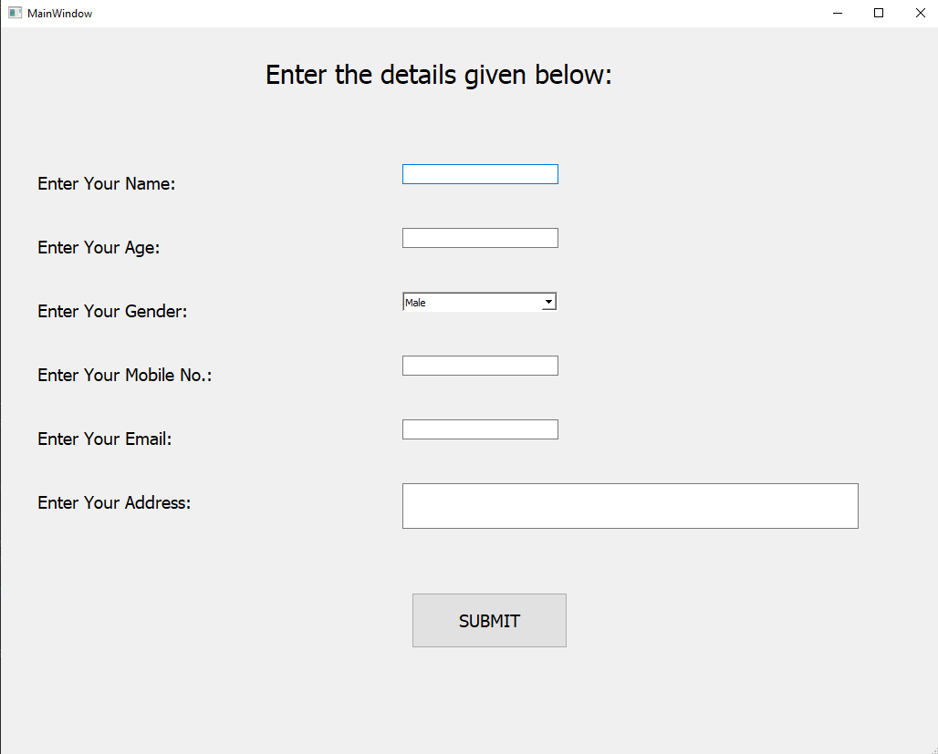
After clicking the NEW USER button this window will open.

Slide 25
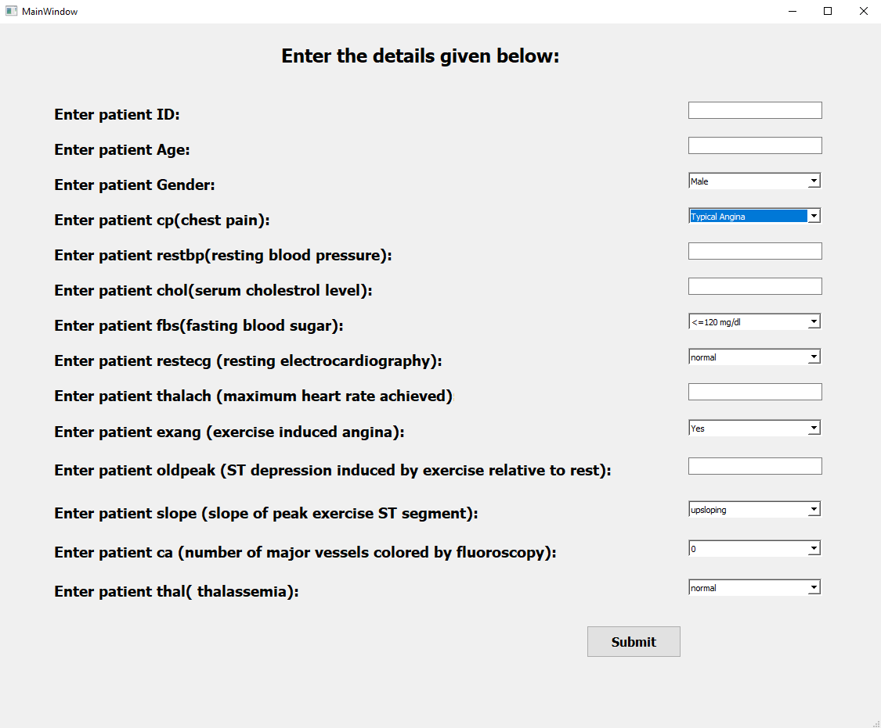
If you are OLD USER then this window will open.

Slide 26
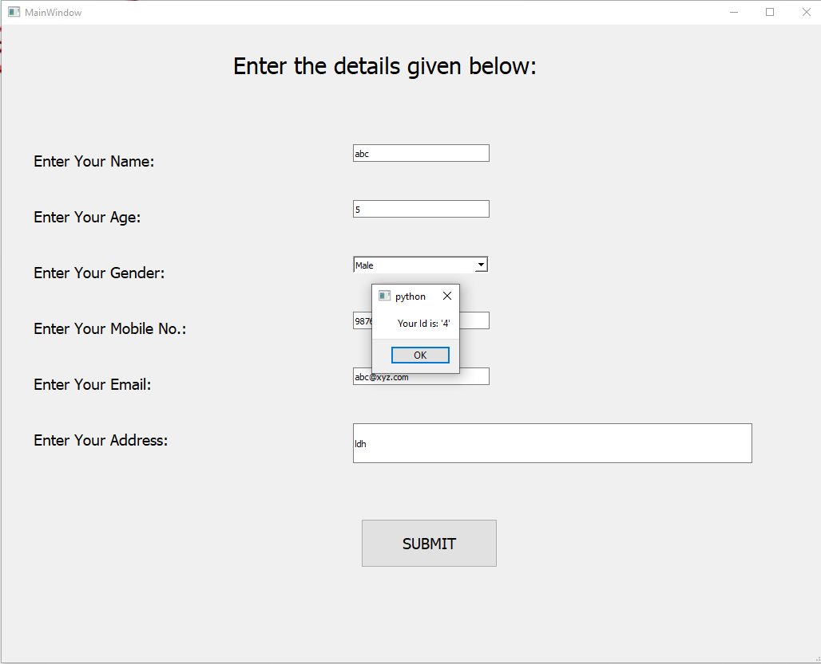
After filling the details in NEW USER window, click on submit button. It will show you popup message of your “ID”.
After clicking the ok button, new window will open.

Slide 27
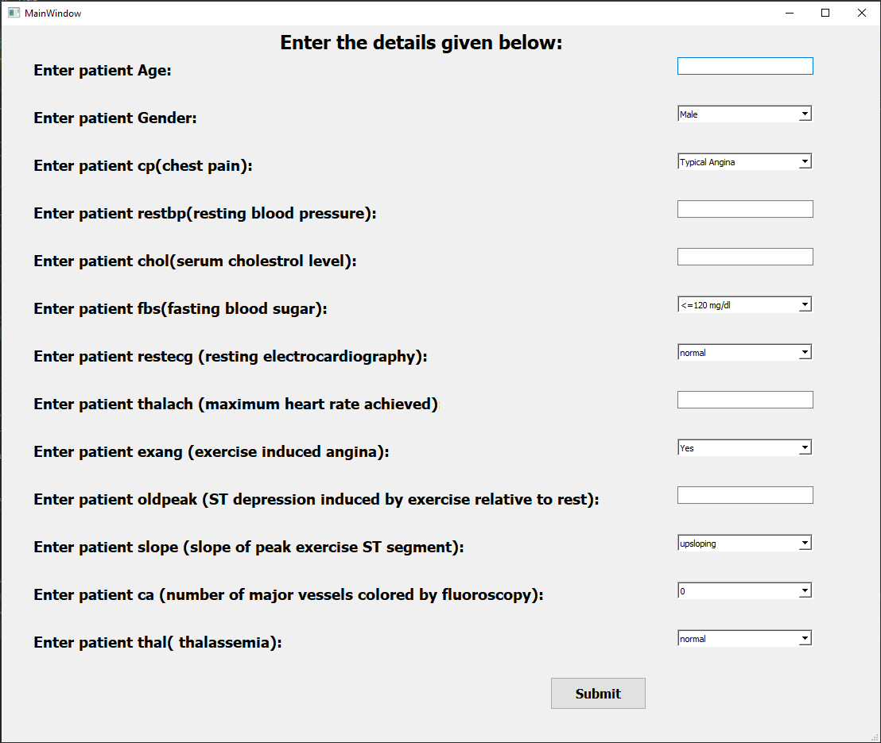
Fill the details given and click on submit button.

Slide 28
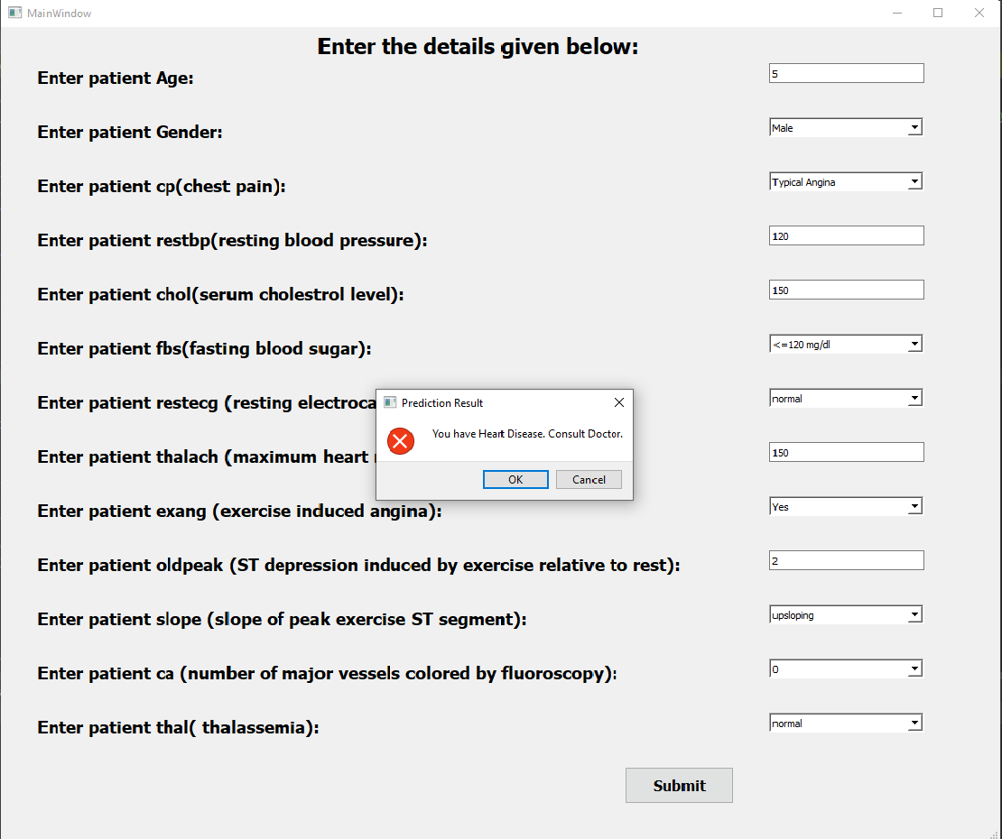
After clicking the submit button then this popup message of prediction result will tell you that you have a heart disease or not.

Slide 29
THANK YOU

